Slide 1
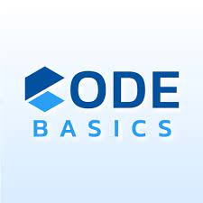

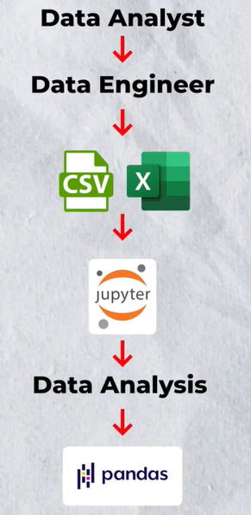
AtliQ Hotel Analysis
Project made using Python
Presented by:- Aashutosh Marathe

Slide 2
Problem Statement and Challenges
AtliQ Grands, a well-established hotel chain operating in Delhi, Mumbai, Bangalore, and Hyderabad for the past 20 years, is currently facing significant challenges in its operations. Despite its extensive experience and diverse offerings, the company is experiencing a decline in revenue and market share.
Challenges:
Declining Revenue: AtliQ Grands is witnessing a decrease in revenue, indicating potential issues with customer acquisition, retention, or pricing strategies.
Market Share Loss: The company's market share is diminishing, suggesting increased competition or decreased brand visibility and appeal.

Slide 3
Background
AtliQ Grands operates a variety of hotel types, including AtliQ Season, AtliQ Exotica, AtliQ Bay, and AtliQ Palace, catering to different customer preferences and needs. Additionally, the company offers various room types, such as Standard, Elite, Premium, and Presidential, ensuring a personalized experience for guests. To facilitate bookings, AtliQ Grands provides a user-friendly website for online reservations. Alternatively, guests can book accommodations through third-party websites, enhancing accessibility and convenience.

Slide 4
Objectives
The primary objective is to address the challenges faced by AtliQ Grands and devise strategies to improve revenue generation and regain lost market share.
Proposed Strategic Marketing Initiatives: Implement targeted marketing campaigns to enhance brand visibility and attract new customers. This could involve promotions, loyalty programs, and partnerships with travel agencies or online booking platforms.
Enhanced Customer Experience: Focus on delivering exceptional customer service and personalized experiences to improve guest satisfaction and loyalty. This may include staff training, amenities upgrades, and technology integration for streamlined operations.
Competitive Pricing Strategies: Analyze pricing structures to ensure competitiveness in the market while maintaining profitability. This could involve dynamic pricing strategies based on demand, seasonal fluctuations, and competitor analysis.
Online Presence Optimization: Enhance the company's online presence through search engine optimization (SEO), social media marketing, and online reputation management. This will improve visibility and attract potential customers through digital channels.

Slide 5
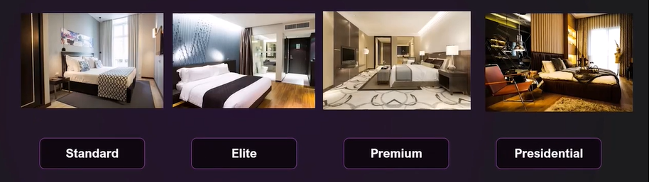
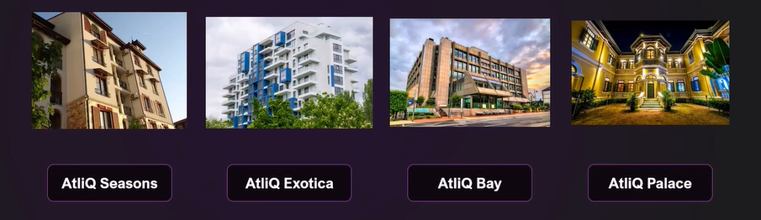
Room Types:
Hotel Types:

Slide 6
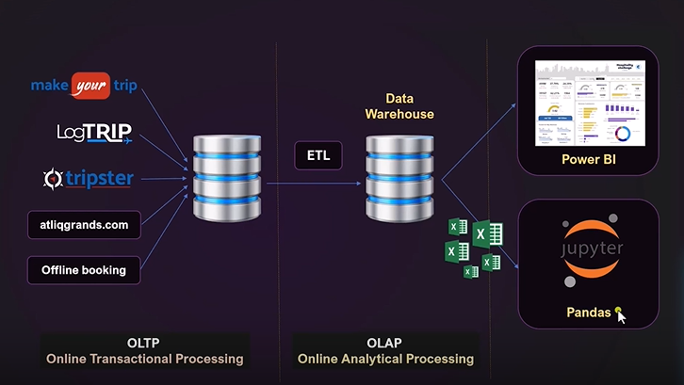
Data Processing System

Slide 7
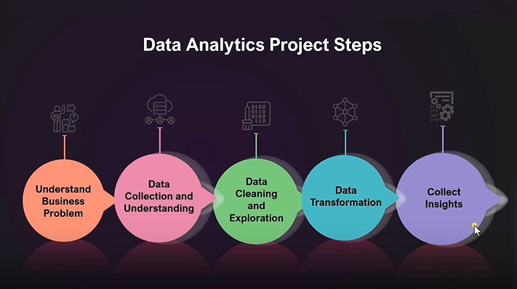

Slide 8
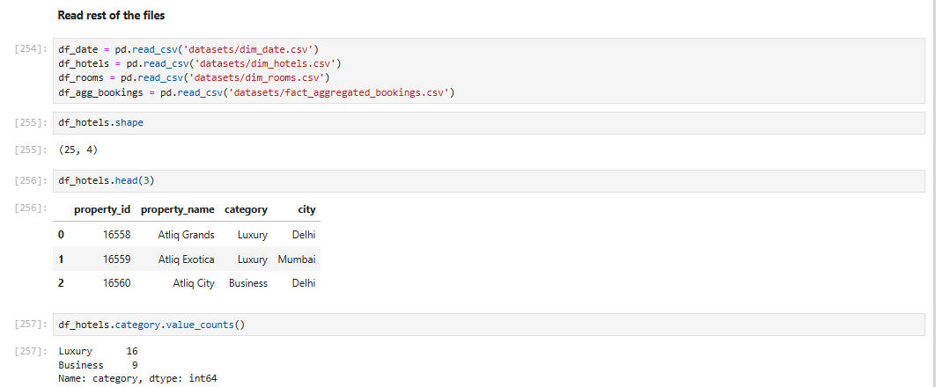
Data Sets:-
Data Sets used:- dim_date, dim_hotel, dim_rooms, fact_aggregated_bookings, fact_bookings, new_data_august

Slide 9
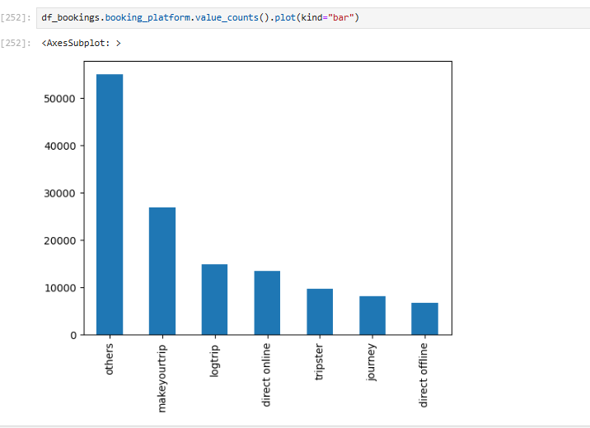
Using Library MatplotLib:

Slide 10
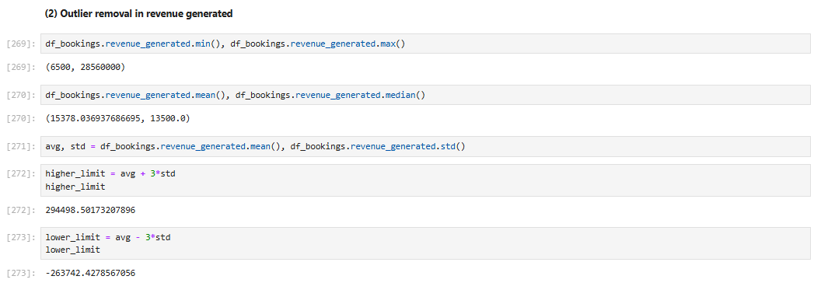
Data Cleaning:

Slide 11
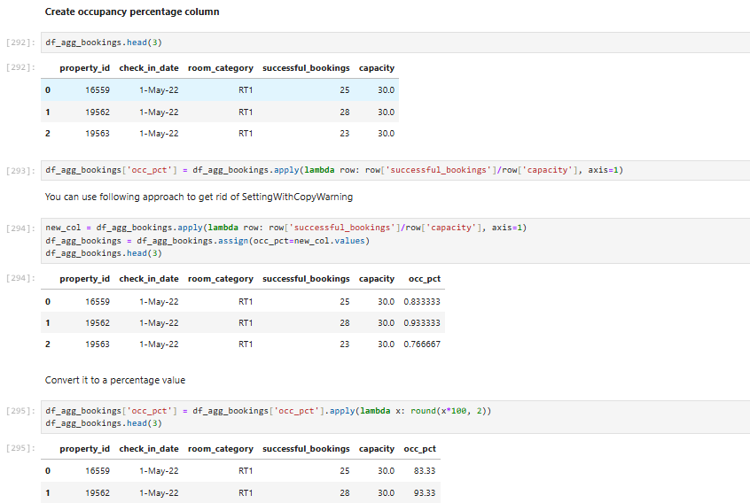
Data Transformation:

Slide 12
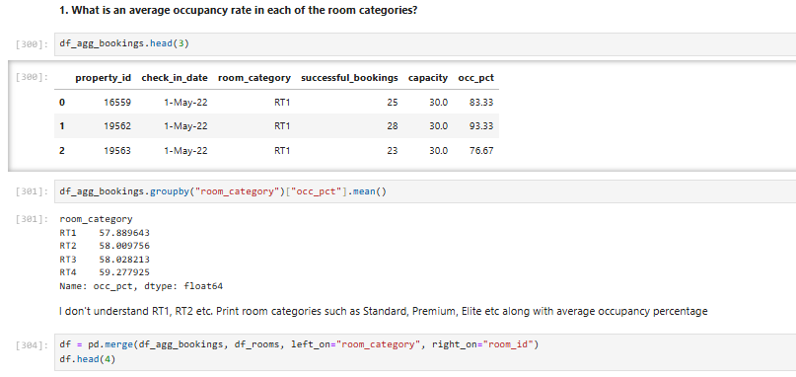
Insight Generation:

Slide 13
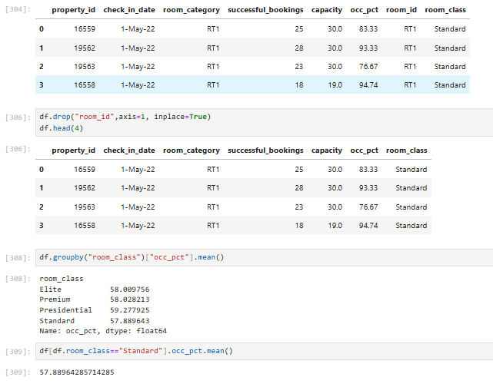

Slide 14
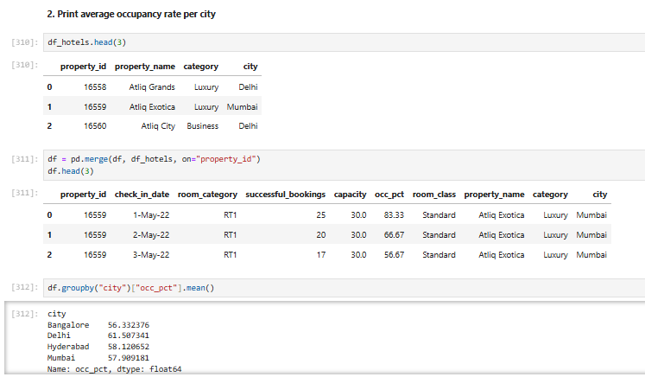

Slide 15
